Slide 1
Linear motion and force
Scalars and Vectors
Vector addition and subtraction
Vector components
Acceleration down a slope
Graphing motion
Vertical motion
Newton’s laws
Momentum
Impulse
Energy

Slide 2
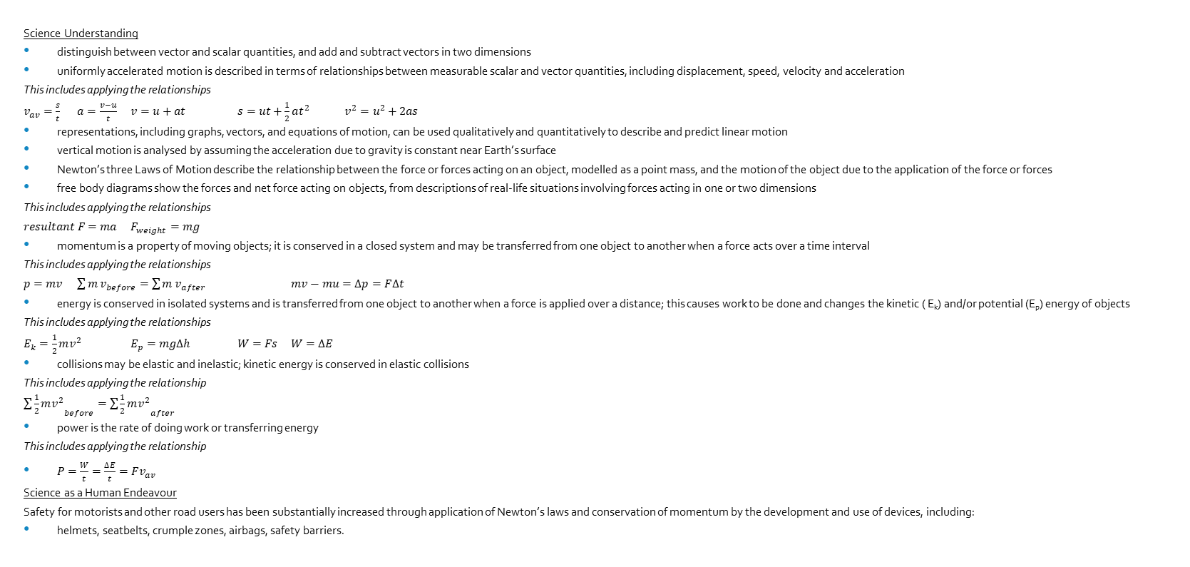
SCSA ATAR Syllabus (last updated 14/11/17; https://senior-secondary.scsa.wa.edu.au/syllabus-and-support-materials/science/physics)
Science Understanding
distinguish between vector and scalar quantities, and add and subtract vectors in two dimensions
uniformly accelerated motion is described in terms of relationships between measurable scalar and vector quantities, including displacement, speed, velocity and acceleration
This includes applying the relationships
$v_{av}=\frac{s}{t}$ $a=\frac{v−u}{t}$ $v=u+at$ $s=ut+\frac{1}{2}at^{2}$ $v^{2}=u^{2}+2as$
representations, including graphs, vectors, and equations of motion, can be used qualitatively and quantitatively to describe and predict linear motion
vertical motion is analysed by assuming the acceleration due to gravity is constant near Earth’s surface
Newton’s three Laws of Motion describe the relationship between the force or forces acting on an object, modelled as a point mass, and the motion of the object due to the application of the force or forces
free body diagrams show the forces and net force acting on objects, from descriptions of real-life situations involving forces acting in one or two dimensions
This includes applying the relationships
$resultant F=ma$ $F_{weight}=mg$
momentum is a property of moving objects; it is conserved in a closed system and may be transferred from one object to another when a force acts over a time interval
This includes applying the relationships
$p=mv$ $\sum{m}v_{before}=\sum{m}v_{after}$ $mv−mu=∆p=F∆t$
energy is conserved in isolated systems and is transferred from one object to another when a force is applied over a distance; this causes work to be done and changes the kinetic ( E_{k}) and/or potential (E_{p}) energy of objects
This includes applying the relationships
$E_{k}=\frac{1}{2}mv^{2}$ $E_{p}=mg∆h$ $W=Fs$ $W=∆E$
collisions may be elastic and inelastic; kinetic energy is conserved in elastic collisions
This includes applying the relationship
$\sum{{\frac{1}{2}mv^{2}}_{before}}=\sum{{\frac{1}{2}mv^{2}}_{after}}$
power is the rate of doing work or transferring energy
This includes applying the relationship
$P=\frac{W}{t}=\frac{∆E}{t}=Fv_{av}$
Science as a Human Endeavour
Safety for motorists and other road users has been substantially increased through application of Newton’s laws and conservation of momentum by the development and use of devices, including:
helmets, seatbelts, crumple zones, airbags, safety barriers.

Slide 3
Initial definitions
Distance: total length of space
Displacement (s): straight-line length of space between two points with the direction
Speed: rate of change of distance
Velocity (v): rate of change of displacement, including direction
Acceleration (a): rate of change of velocity, including direction

Slide 4
Fun fact
Rate of change of acceleration is called ‘jerk’ (m s⁻³)
Rate of change of jerk is called ‘jounce’ or ‘snap’ (m s⁻⁴)
Rate of change of snap is called ‘crackle’ (m s⁻⁵)
Rate of change of crackle is called ‘pop’ (m s⁻⁶)
Rate of change of pop is called ‘lock’ (m s⁻⁷)
Rate of change of lock is called ‘drop’ (m s⁻⁸)
http://iopscience.iop.org/article/10.1088/0143-0807/37/6/065008

Slide 5

Initial equations
$$v=\frac{s}{t}$$
$$a=\frac{v−u}{t}$$
$$s=ut+\frac{1}{2}at^{2}$$
$$v^{2}=u^{2}+2as$$

Slide 6
Scalars vs Vectors
Have magnitude (size) only
E.g.
Distance: 3 m
Speed: 12 m s⁻¹
Time: 9 s
Mass: 30 kg
Energy: 110 J
Have magnitude (size) and direction
E.g.
Displacement: 3 m S
Velocity: 12 m s⁻¹ N20°W
Acceleration: 9.8 m s⁻² down
Force: 50N 015 °
Momentum: 240 kg m s⁻¹ forwards

Slide 7
Distance vs Displacement
Distance is how far an object has travelled from its starting point. (Scalar: magnitude)
Displacement is how far an object is from its starting point with the direction. (Vector: magnitude with direction)
Displacement is the straight line distance from start to finish.
E.g. swimmer having done 1,2,3 laps of a 50m pool.
E.g. athlete running around a 400m circuit track.
1 lap: distance=50m displacement=50m forwards
2 laps: distance=100m displacement=0m
3 laps: distance=150m displacement=50m forwards
1 lap: distance=400m displacement=0m

Slide 8
Speed vs Velocity
Speed is the rate of change of distance (scalar)
Velocity is the rate of change of displacement (vector)
Consider Damian, an athlete performing a training routine by running back and forth along a straight stretch of running track. He jogs 100 m north in a time of 20 s, then turns and walks 50 m south in a further 25 s before stopping.
a Calculate Damian’s average speed as he is jogging.
b What is his average velocity as he is jogging?
c What is the average speed for this 150 m exercise?
d Determine the average velocity for this activity.
e What is Damian’s average velocity in km h^{–1}?
a) 5 m s⁻¹ b) 5 m s⁻¹ N c) 3.33 m s⁻¹ d) 1.11 m s⁻¹ N e) 4 km h⁻¹ N

Slide 9
Instantaneous vs average speed/velocity
Instantaneous speed/velocity refers to how fast an object is moving at a specific moment in time
Average speed/velocity refers to how fast an object completed a journey

Slide 10
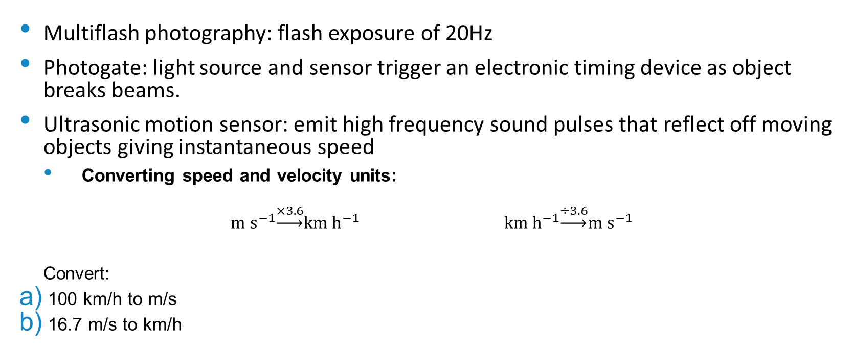
Measuring speed/velocity
Multiflash photography: flash exposure of 20Hz
Photogate: light source and sensor trigger an electronic timing device as object breaks beams.
Ultrasonic motion sensor: emit high frequency sound pulses that reflect off moving objects giving instantaneous speed
Converting speed and velocity units:
$$m s^{−1}\underset{→}{×3.6}km h^{−1} km h^{−1}\underset{→}{÷3.6}m s^{−1}$$
Convert:
100 km/h to m/s
16.7 m/s to km/h

Slide 11
Ticker Timers
Hammer vibrates with a frequency of 50 Hz
Time between dots = 1/50s = 0.02s
Distance travelled = length of tape between dots
Dots close together = slow movement
Dots far apart = fast movement

Slide 12
Representation of Vectors
Use an arrow
Draw to scale (include scale)
Directions
True bearings: from North clockwise
Compass bearings: N/S ° W/E
Left, right, up, down, forwards, backwards

Slide 13
Addition of Vectors
Vectors are added head to tail and the resultant (R) goes from the tail of the first to the head of the last.
The resultant can be determined by calculation or scaled diagram.
E.g.
V2
V1
V1
R
V2

Slide 14
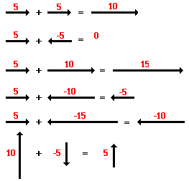
Vector addition in one dimension
Treat one direction as positive, the other as negative

Slide 15
One dimension example
A train travels 250 km West, then stops and returns 100 km East, then travels 25km West.
What is the train’s displacement from its starting point?
What distance did the train cover?
250-100+25= 175km West
250+100+25= 375km

Slide 16
Vector addition in two dimensions
Draw a rough vector diagram
Use Pythagoras to find the magnitude (requires a right angle)
Use tangent function to find the direction.
E.g. If a person travels 4 km E, then 3 km N, what is their resultant displacement?
R²=3²+4²
R=5 km
tan θ = 3/4
θ = 36.9 °
True bearing = 90 – 36.9 = 053.1 °
R
3km
θ
4km

Slide 17
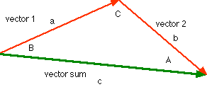
By calculation : sin and cos rule
COS RULE
c² = a² + b² – 2ab cos C
SIN RULE
a/ sin A = b/ sin B = c/ sin C

Slide 18
Vector addition example
Sally and Ken kick a stationary ball simultaneously with forces of 100 N South and 150 N South-East respectively. What is the resultant force on the ball?
232 N 153°

Slide 19
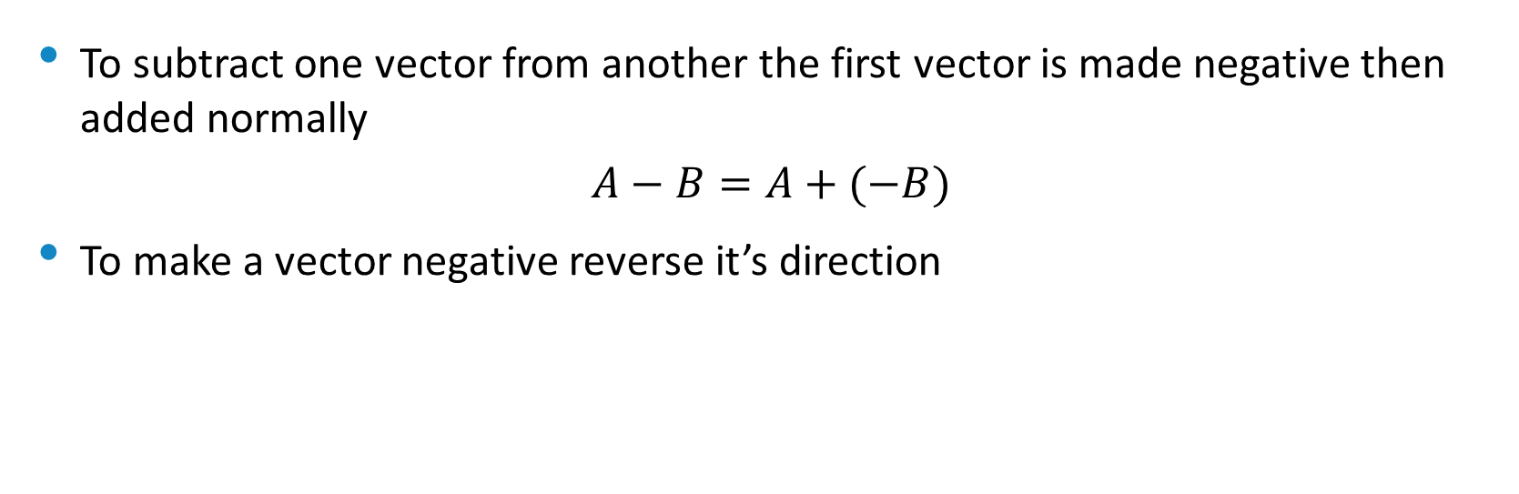
Vector Subtraction
To subtract one vector from another the first vector is made negative then added normally
$$A−B=A+(−B)$$
To make a vector negative reverse it’s direction
B
-B

Slide 20

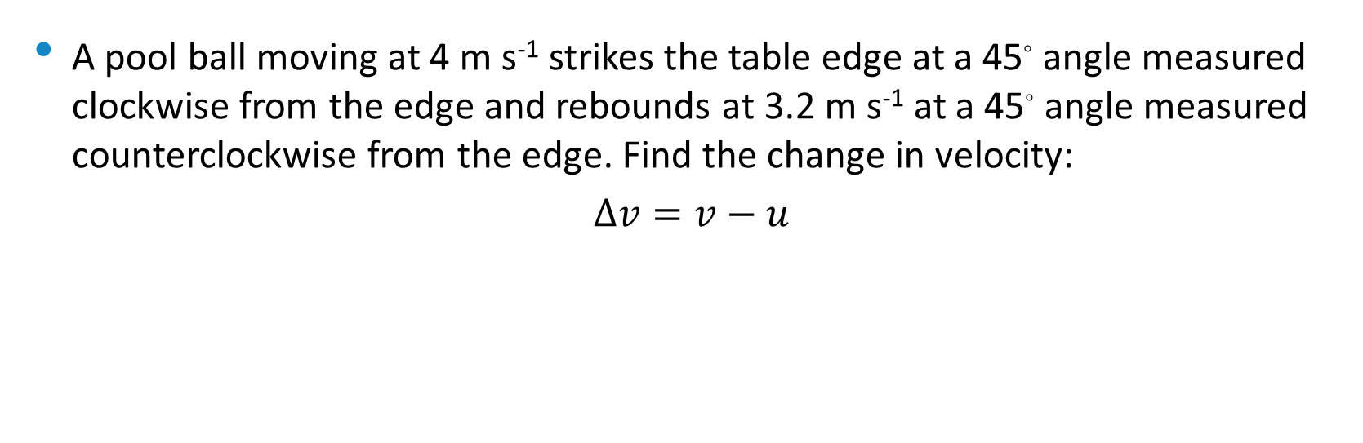
Vector Subtraction Example
A pool ball moving at 4 m s⁻¹ strikes the table edge at a 45◦ angle measured clockwise from the edge and rebounds at 3.2 m s⁻¹ at a 45◦ angle measured counterclockwise from the edge. Find the change in velocity:
$$∆v=v−u$$
v= 3.2 m s⁻¹
$$∆v=\sqrt{{3.2}^{2}+4^{2}}$$
$$∆v=5.12$$
$$θ=\tan^{−1}\left(\frac{3.2}{4}\right)$$
$$θ=38.7°$$
$$∆v=5.12 m s^{−1} at a 83.7° angle$$
$$measured clockwise from the edge$$
45◦
θ
u= 4 m s⁻¹
45◦
v= 3.2 m s⁻¹
45◦
-u= 4 m s⁻¹

Slide 21
Example
An aeroplane flies 125 km south when the pilot received an emergency call. The pilot changed direction to west, flying 85.0 km where he landed the plane at a farmhouse.
Draw a vector diagram to show the resultant displacement.
The pilot gives the radio operator his displacement from the home base. Work out his displacement.
In which direction must the pilot head if he is to take the injured farmer to home base as quickly as possible.

Slide 22
Resolution of vectors
Any vector in two-dimensional space can be thought of as having an influence in two perpendicular directions.
Each part of a two-dimensional vector is known as a component.
A vector can be resolved into its component parts.
Components are typically at right angles to one another.
A vector is equal to the sum of its component.

Slide 23
Vector components
The vector ‘A’ can be thought of as being made of components ‘B’ and ‘C’
Components can be determined using trigonometry
E.g. C = A sin θ
E.g. B = A cos θ
A
C
θ
B

Slide 24
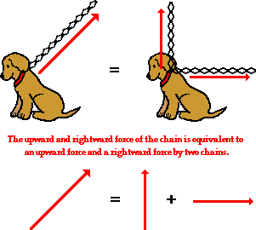
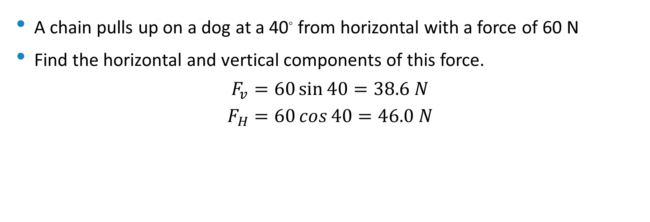
Example
A chain pulls up on a dog at a 40◦ from horizontal with a force of 60 N
Find the horizontal and vertical components of this force.
$$F_{v}=60\sin{40}=38.6 N$$
$$F_{H}=60\cos{40}=46.0 N$$

Slide 25
Example
A boy pushes a go-cart with a force of 2480N at an angle of 25.000 down from the horizontal.
a) Determine the horizontal and vertical components of the force.
b) Explain the effect on the go-cart and its motion for each component.

Slide 26
Acceleration down a slope
An object in freefall on Earth is said to fall at 9.8 ms⁻²
An object on a slope will fall at a smaller rate
The acceleration down a slope due to gravity is the component of gravity acting parallel to the slope (ignore friction)

Slide 27
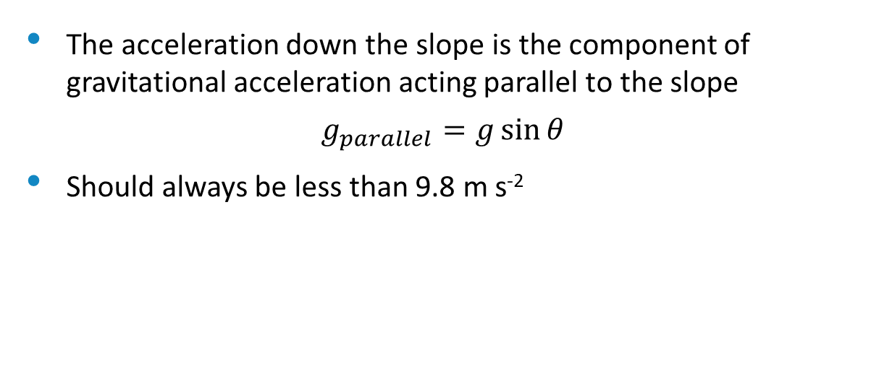
The acceleration down the slope is the component of gravitational acceleration acting parallel to the slope
$$g_{parallel}=g\sin{θ}$$
Should always be less than 9.8 m s⁻²
g_{parallel}
g
g_{perpendicular}
θ
θ

Slide 28
Displacement-time graphs
Plots position of an object relative to a reference point (0 on the y-axis)
Gradient = velocity
Straight line = constant velocity

Slide 29
Displacement-time graph example
Describe the motion of the object
Determine the velocity at 5 s
Determine the total distance travelled
0-10s: moves forwards with constant velocity, 10-15s: moves backwards with constant velocity to the reference point, 15-20s: moves backwards with constant velocity, 20-25s: remains stationary
0.4 ms⁻¹ forwards
13m

Slide 30

Gradient
Formula for gradient often written:
$$gradient=\frac{rise}{run}$$
Better as:
$$gradient=\frac{Δrise}{Δrun} or gradient=\frac{Δy}{Δx}$$

Slide 31
Velocity-time graphs
Plots velocity of an object over time
Gradient = acceleration
Horizontal line = constant velocity
Area under the curve = displacement

Slide 32
Velocity-time graph example
Describe the motion of the object
Determine the acceleration at 12 s
Determine the final displacement
0-10s: moves forwards with constant positive acceleration, 10-15s: moves forwards with constant negative acceleration coming to a stop, 15-20s: moves backwards with constant negative acceleration (getting faster), 20-25s: moves backwards at constant velocity
-1.2 ms⁻²
22.5m forwards

Slide 33
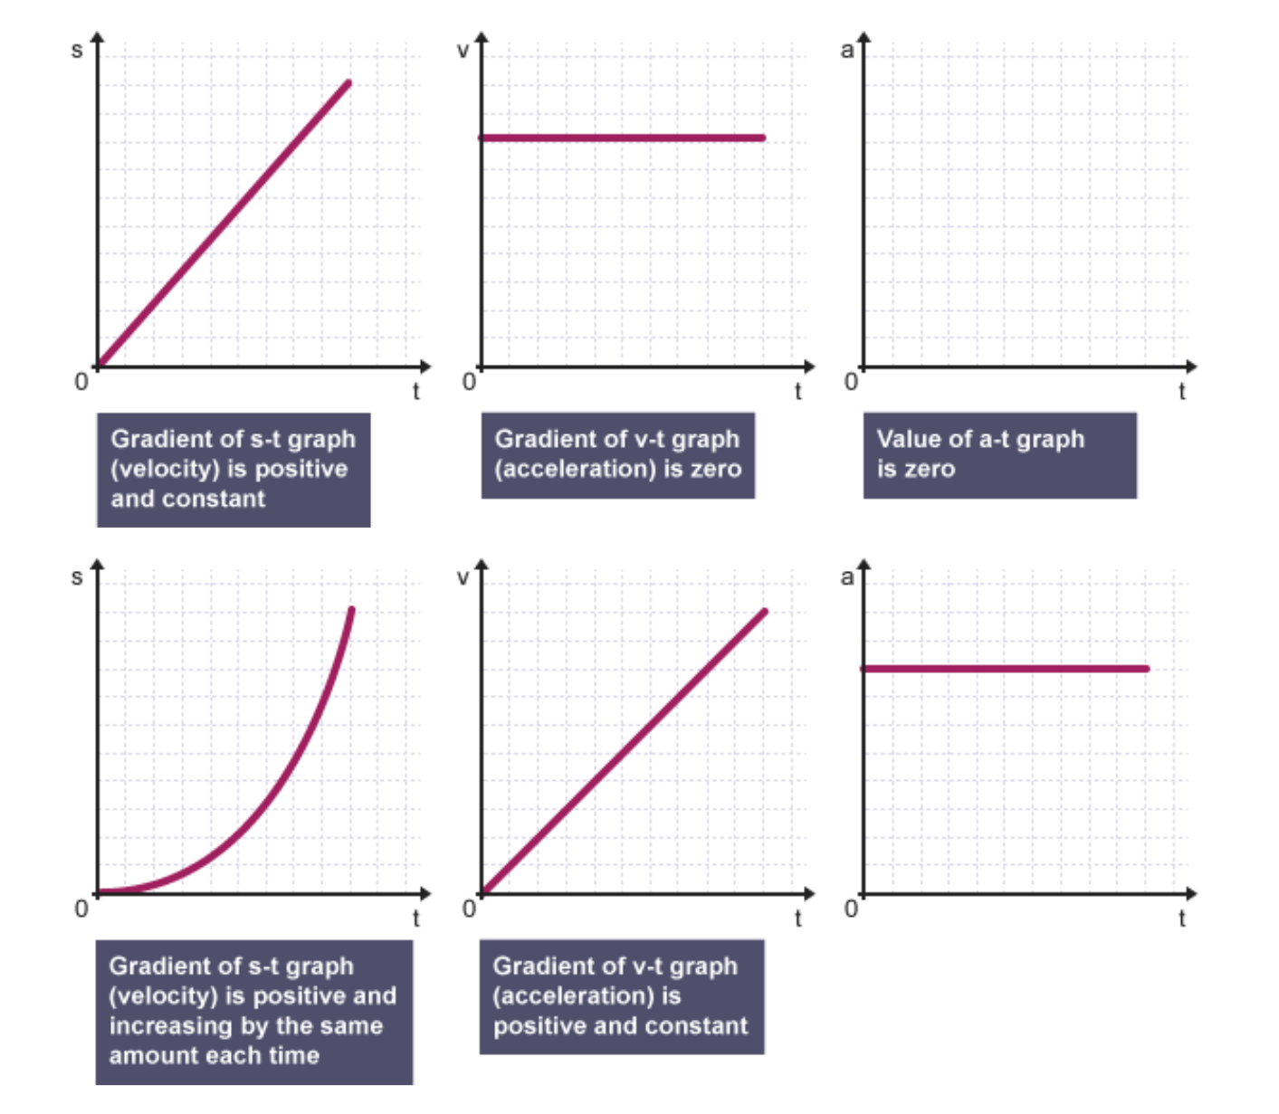
Graphs and motion

Slide 34
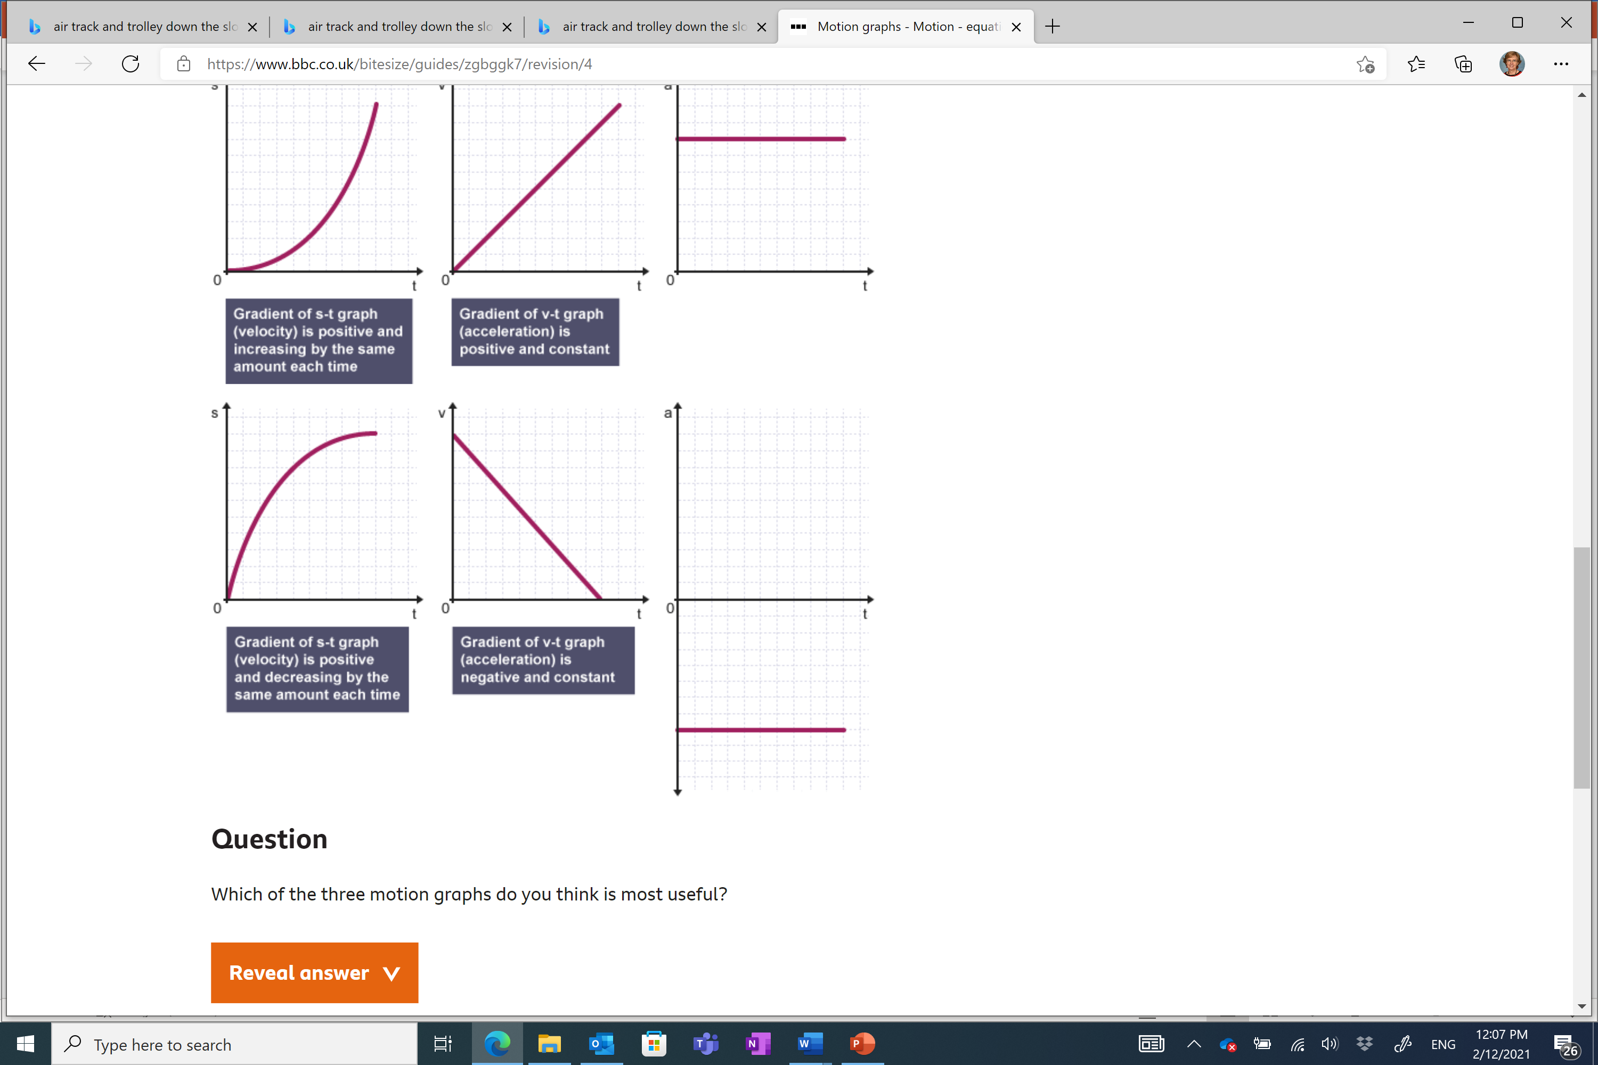
Graph: Decelerating
(BBC, 2021)

Slide 35
Vertical motion
Assume that gravitational acceleration near the surface of the Earth is constant and that it is 9.8 ms⁻²
Recognise that the vertical component of an objects velocity becomes 0 at the peak of its flight
Ignore air resistance
Time up = time down (if distance up = distance down)
Apply equations of motion as normal
Up is positive, down is negative

Slide 36
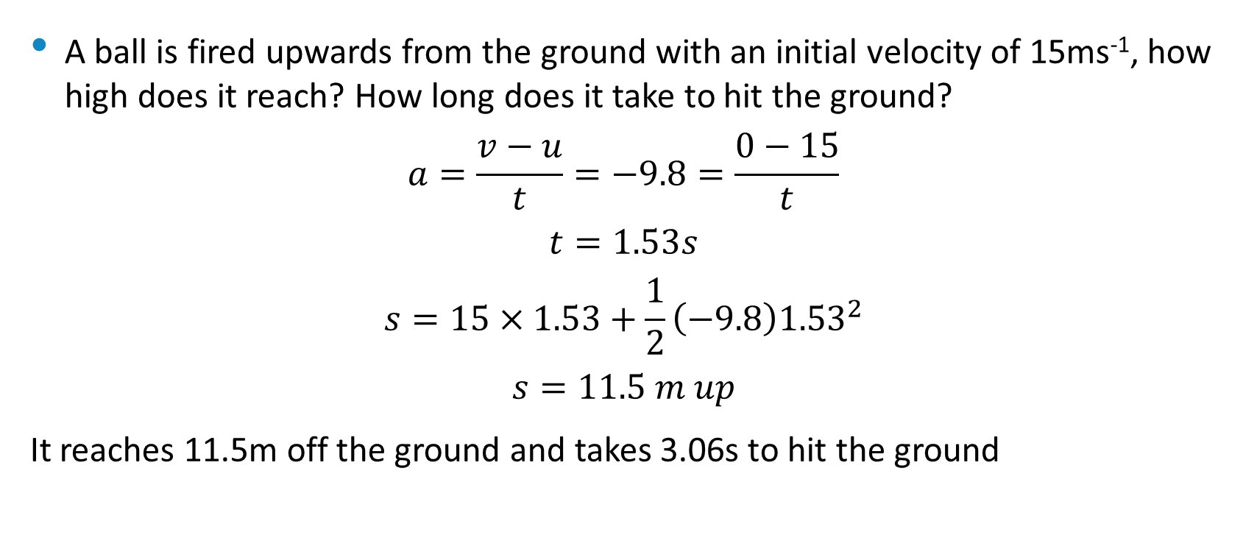
Vertical motion example
A ball is fired upwards from the ground with an initial velocity of 15ms⁻¹, how high does it reach? How long does it take to hit the ground?
$$a=\frac{v−u}{t}=−9.8=\frac{0−15}{t}$$
$$t=1.53s$$
$$s=15×1.53+\frac{1}{2}\left(−9.8\right){1.53}^{2}$$
$$s=11.5 m up$$
It reaches 11.5m off the ground and takes 3.06s to hit the ground

Slide 37

Vertical motion example 2
A ball is fired upwards off a 4m cliff with an initial velocity of 15ms⁻¹ up, how high does it reach? How long does it take to hit the ground at the base of the cliff?
$$a=\frac{v−u}{t}=−9.8=\frac{0−15}{t}$$
$$t_{up}=1.53s$$
$$s=15×1.53+\frac{1}{2}\left(−9.8\right){1.53}^{2}$$
$$s=11.5 m up$$
$$−15.5=0×t_{down}+\frac{1}{2}\left(−9.8\right){t_{down}}^{2}$$
$$t_{down}=1.78s$$
It reaches 11.5m off the cliff and takes 3.31s to hit the ground

Slide 38
Forces
Are pushes or pulls
Measured in Newtons (N) or kg m s⁻²
Vectors, so include both magnitude and direction
Described by Newton’s Laws
http://australia.twig-world.com/films/forces-of-nature-1498/
http://australia.twig-world.com/films/newtons-laws-of-motion-1490/

Slide 39
1st Law – Law of inertia
An object in motion will remain in motion unless acted on by an unbalanced force
An object at rest will remain at rest unless acted on by an unbalanced force

Slide 40
Examples
A puck moving over a frictionless layer of ice.
A puck moving over a rough surface.
Throw a ball in space.
Fall into aisle when bus turns.
Eggs on the back seat

Slide 41
Inertia
The property of mass to resist changes to its state of motion
Proportional to mass

Slide 42
Balanced forces
The forces acting on an object are considered balanced if the vector sum of the forces is 0
If the forces acting on an object are not balanced the object will accelerate

Slide 43
Free body diagrams
Show relative size and direction of all forces acting on an object
Labelled to show the types of forces
Size of arrow indicates magnitude of force
If on Earth always include weight force
If moving on Earth always include friction force (friction, drag, air resistance)
If resting on a surface include normal force

Slide 44
Example
A cyclist pedals so she travels with a constant velocity of 8.0 m/s west. If the frictional forces applied to her are 60N, what force must be supplied by the rear wheel of the bicycle?
60N forward

Slide 45
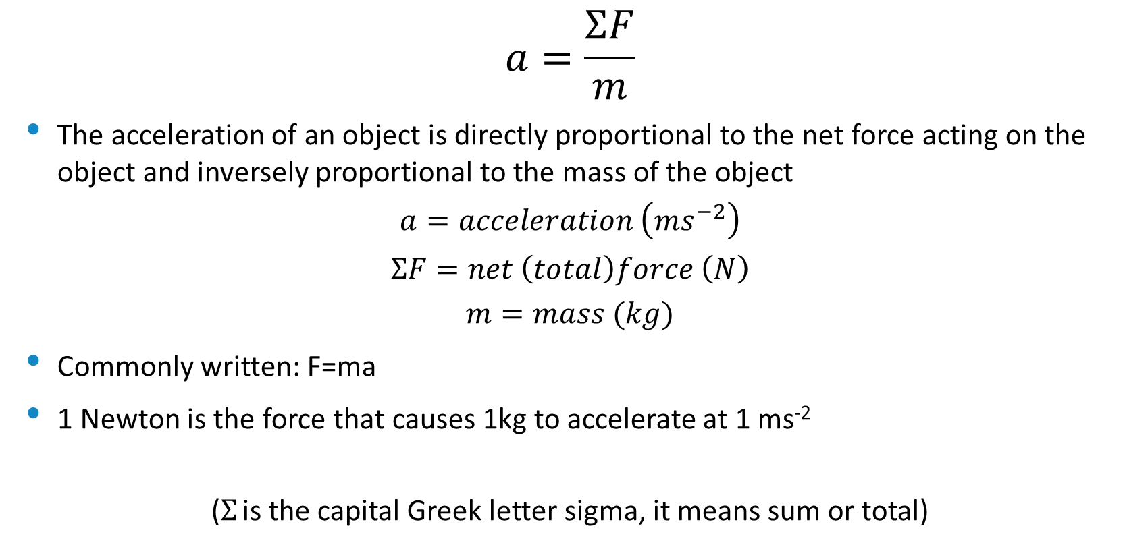
2nd Law
$$a=\frac{ΣF}{m}$$
The acceleration of an object is directly proportional to the net force acting on the object and inversely proportional to the mass of the object
$$a=acceleration \left(ms^{−2}\right)$$
$$ΣF=net \left(total\right)force \left(N\right)$$
$$m=mass (kg)$$
Commonly written: F=ma
1 Newton is the force that causes 1kg to accelerate at 1 ms⁻²
($Σ$ is the capital Greek letter sigma, it means sum or total)

Slide 46
Examples:
Determine the size of the force required to accelerate a 80 kg athlete from rest to 12 ms⁻¹ in 5.0 s.
192N
A 150g hockey ball is simultaneously struck by 2 hockey sticks. If the sticks supply a force of 15 N north and 20 N east respectively, determine the acceleration of the ball and direction it will travel.
167ms⁻² N 53⁰ E 053.1⁰
A freestyle swimmer whose mass is 75kg applies a force of 350N. The water opposes her efforts with a 200N force. What is her initial acceleration?
2.0ms⁻² in direction of applied force.

Slide 47
Force and acceleration
Force must be in direction of acceleration.
E.g. pulling a cart with a string at 10⁰ to horizontal.
Cart on a slope.
Eg: A 780 kg car is travelling up a slope at a constant 60 km/h. The angle of the slope is 10⁰ and the driving force is 3 000N Determine : a) the friction forces on car b) the normal

Slide 48

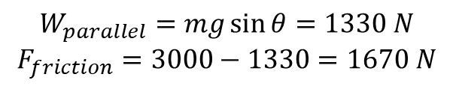
Example solution
Eg: A 780 kg car is travelling up a slope at a constant 60 km/h. The angle of the slope is 10⁰ and the driving force is 3 000N Determine : a) the friction forces on car b) the normal
$$W_{parallel}=mg\sin{θ}=1330 N$$
$$F_{friction}=3000−1330=1670 N$$
F_{Normal}=W_{perpendicular}
F_{d}=3000 N
W_{parallel}+F_{f}=3000 N
$$W_{perpendicular}=mg \cos{θ}=7530 N$$
W=mg=7644 N

Slide 49
Mass and Weight
Mass
Weight
Measured in kg
Measure of quantity of matter
Measure of inertia
Constant for a given object regardless of location
Measured in N
Measure of force acting on an object due to the gravitational field it is in
Varies according to local gravitational acceleration
Product of mass and gravitational acceleration
W =mg

Slide 50
3rd Law
For every action force there is an equal and opposite reaction force
E.g. If object A exerts a force of 10N right on object B, then object B also exerts a force of 10N left on object A
The two forces:
Are equal in magnitude
Opposite in direction
Act on different objects
Are the same type
Act for the same duration

Slide 51
Examples
A trailer accelerated by a car.
Skydiver
Basketball player
Explain how you walk
Car being driven
Jet aircraft
http://australia.twig-world.com/films/how-do-animals-fly-1494/
http://australia.twig-world.com/films/how-do-planes-fly-1495/

Slide 52
Normal/reaction force and apparent weight
An object resting on a surface experiences a normal force opposing its weight force
The normal force is always perpendicular to the surface, even if the surface is inclined
Responsible for the sensation of weight, in freefall you feel ‘weightless’ because you are not experiencing a normal force
A scale can be though of as measuring the normal force

Slide 53
Elevator problems
Can ask for the normal force experienced by a person in an elevator:
While stationary
While moving up/down at constant velocity
While accelerating upwards
While accelerating downwards
For each scenario, from personal experience, do you feel heavier, lighter or normal?
This should inform your answers to calculations
Normal
Normal
Heavier
Lighter

Slide 54
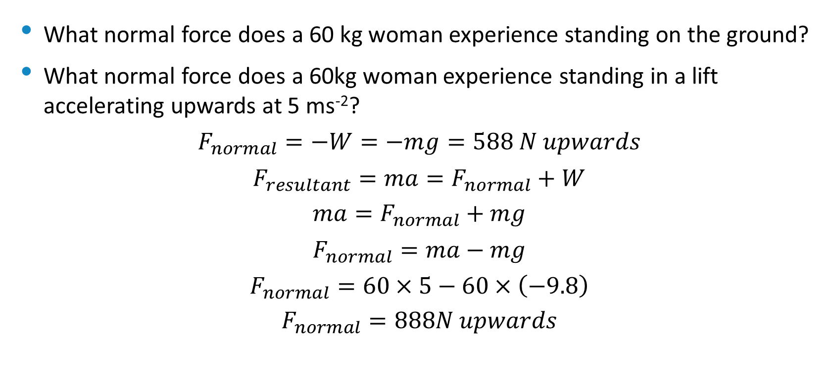
Elevator example 1
What normal force does a 60 kg woman experience standing on the ground?
What normal force does a 60kg woman experience standing in a lift accelerating upwards at 5 ms⁻²?
$$F_{normal}=−W=−mg=588 N upwards$$
$$F_{resultant}=ma=F_{normal}+W$$
$$ma=F_{normal}+mg$$
$$F_{normal}=ma−mg$$
$$F_{normal}=60×5−60×\left(−9.8\right)$$
$$F_{normal}=888N upwards$$
F_{normal}=?
Accelerating up at 5 ms⁻²
W=-588N

Slide 55

Elevator example 2
What normal force does a 60 kg woman experience standing on the ground?
What normal force does a 60kg woman experience standing in a lift accelerating downwards at 6 ms⁻²?
$$F_{normal}=−W=−mg=588 N upwards$$
$$F_{resultant}=ma=F_{normal}+W$$
$$ma=F_{normal}+mg$$
$$F_{normal}=ma−mg$$
$$F_{normal}=60×(−6)−60×\left(−9.8\right)$$
$$F_{normal}=228N upwards$$
F_{normal}=?
Accelerating down at 6 ms⁻²
W=-588N

Slide 56

Elevator example 3
What normal force does a 60 kg woman experience standing on the ground?
What normal force does a 60kg woman experience standing in a lift accelerating downwards at 16 ms⁻²?
$$F_{normal}=−W=−mg=588 N upwards$$
$$F_{resultant}=ma=F_{normal}+W$$
$$ma=F_{normal}+mg$$
$$F_{normal}=ma−mg$$
$$F_{normal}=60×(−16)−60×\left(−9.8\right)$$
$$F_{normal}=−372N upwards=372N downwards$$
F_{normal}=?
Accelerating down at 16 ms⁻²
W=-588N

Slide 57

Elevator shortcut
If you are very strict with treating upwards vectors as positive and downwards as negative you can simply use:
$$F_{normal}=ma−mg$$
$$F_{normal}=m(a−g)$$

Slide 58
Tension
Force in ropes/wires
Though of as acting in both directions along the rope/wire

Slide 59
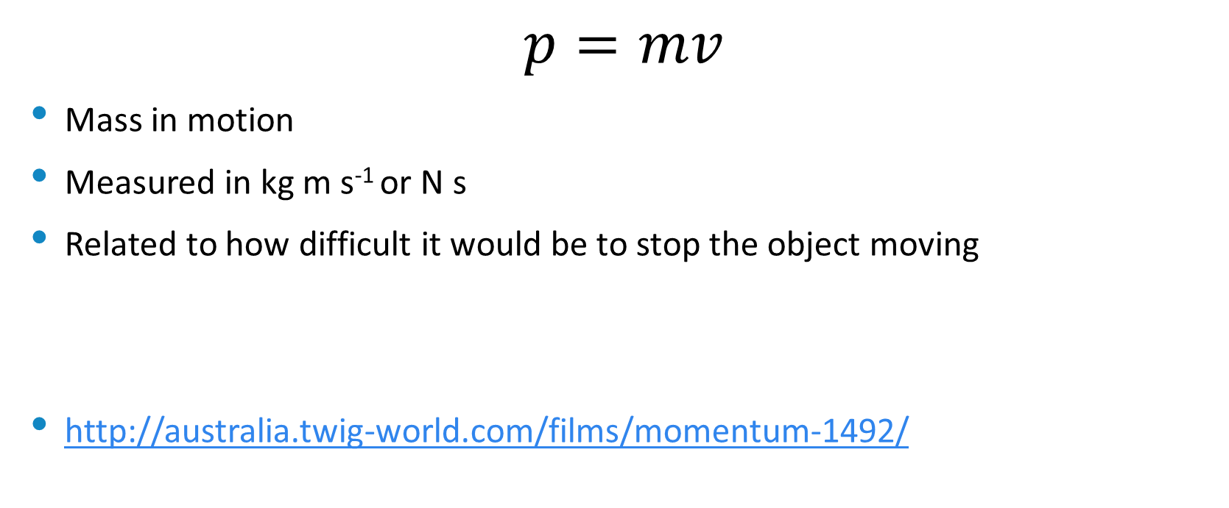
Momentum (p)
$$p=mv$$
Mass in motion
Measured in kg m s⁻¹ or N s
Related to how difficult it would be to stop the object moving
http://australia.twig-world.com/films/momentum-1492/

Slide 60
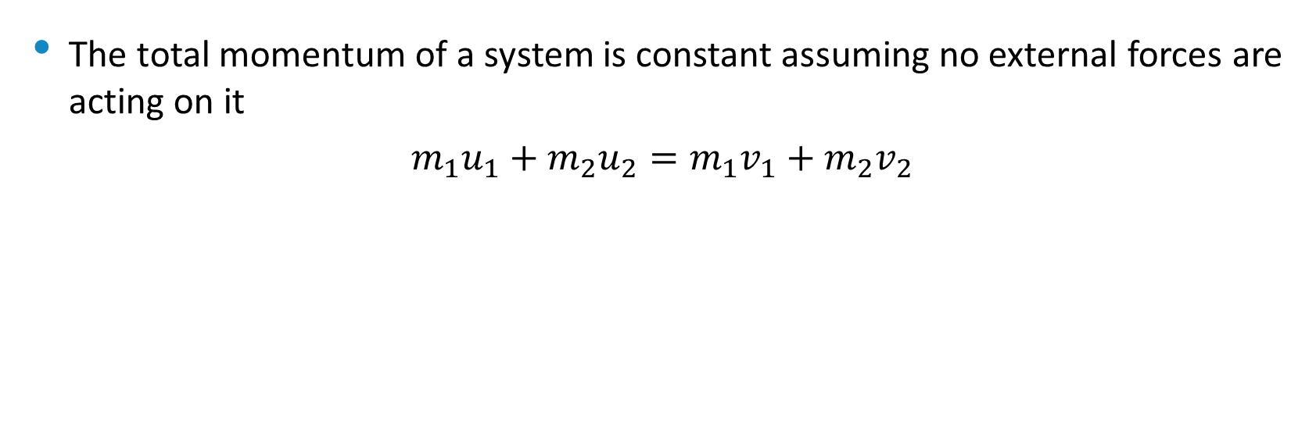
Conservation of momentum
The total momentum of a system is constant assuming no external forces are acting on it
$$m_{1}u_{1}+m_{2}u_{2}=m_{1}v_{1}+m_{2}v_{2}$$
u₂
v₂
m₂
m₂
m₁
m₁
u₁
v₁
before
after

Slide 61
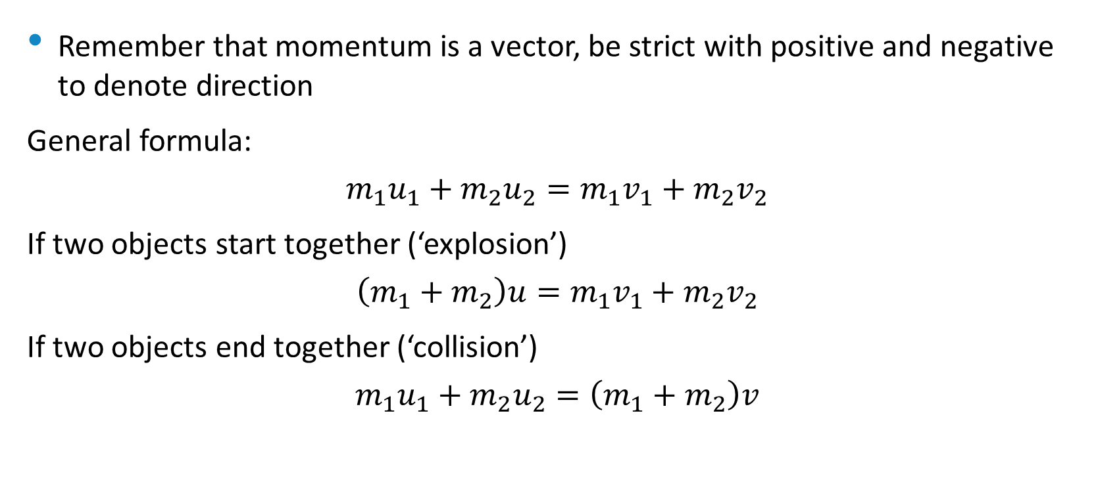
Conservation of momentum
Remember that momentum is a vector, be strict with positive and negative to denote direction
General formula:
$$m_{1}u_{1}+m_{2}u_{2}=m_{1}v_{1}+m_{2}v_{2}$$
If two objects start together (‘explosion’)
$$\left(m_{1}+m_{2}\right)u=m_{1}v_{1}+m_{2}v_{2}$$
If two objects end together (‘collision’)
$$m_{1}u_{1}+m_{2}u_{2}=\left(m_{1}+m_{2}\right)v$$

Slide 62
Example
A skater (80kg) skating in a straight line with a velocity of 6.0m s⁻¹ while another mass 70kg also with a speed of 6.0ms⁻¹ approaches her in an opposite direction.
a) What will happen to lighter skater if 2 collide and the heavier one is brought to a stop.
b) What would happen if skaters stuck together after collision.
a) 0.86 ms⁻¹ in opposite direction b) 0.4ms⁻¹ initial direction of heavier one.

Slide 63
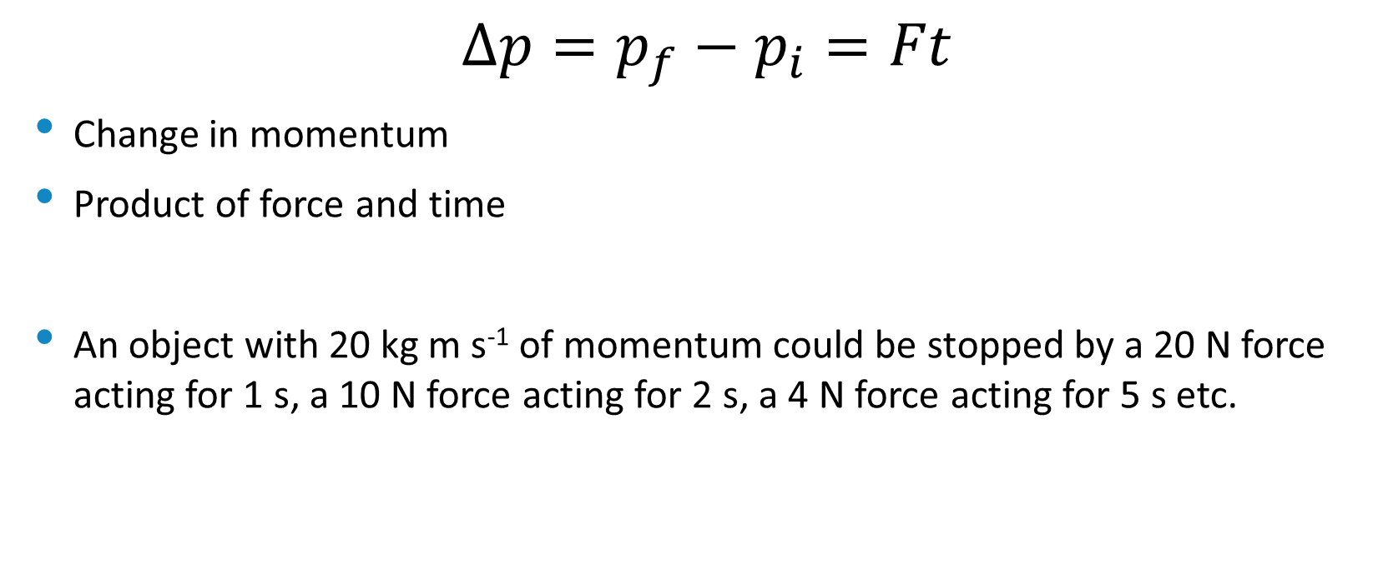
Impulse (∆p)
$$∆p=p_{f}−p_{i}=Ft$$
Change in momentum
Product of force and time
An object with 20 kg m s⁻¹ of momentum could be stopped by a 20 N force acting for 1 s, a 10 N force acting for 2 s, a 4 N force acting for 5 s etc.

Slide 64
Example
A footballer (80kg) running at 8.2 m s⁻¹ collides with a goal post and comes to rest while trying to take a mark. He is brought to a standstill in 0.1s
a) Determine the footballers change in momentum
b) Determine the average force he experienced during the collision.
a) -656kgms⁻¹ b) 6560 N away from pole

Slide 65
Example 2
A tennis ball (58g) travelling at 55ms⁻¹ is struck by a tennis racquet.
a) Find the change in momentum as ball is momentarily brought to a halt.
b) Find magnitude of impulse.
c) Find average force applied to stop ball in 0.15s
a) 3.19 kg m s⁻¹ in opposite direction b) 3.19 N s c) 21.3 N opposite direction to ball’s travel.

Slide 66
Example 3
A tennis ball (58g) travelling at 55ms⁻¹ is struck by a tennis racquet, sending it back the opposite direction at 35 ms⁻¹.
a) Find the change in momentum.
b) Find magnitude of impulse.
c) Find average force applied to hit ball for 0.15s
a) 5.22 kg m s⁻¹ in opposite direction b) 5.22 N s c) 34.8 N opposite direction to ball’s travel.

Slide 67
Crumple zones
Longer time force is applied, the less the force required.
Change in momentum will be the same.
Ft = m(v-u)
Eg: cars crumple zone, egg packaging, bend knees on landing, high jump cushion, airbags, sport shoe design

Slide 68
Example
A person weighs 60kg and lands on a concrete surface after jumping from a height of 6.0m. The impact time when landing with locked knees is 0.002s and with bent knees is 0.050s. Will the person’s tibia bone fracture?
Assume cross sectional area of tibia is 3.0 cm²
Bone strength is 170N mm⁻²
Force required = 5.1 x 10⁴ N
3.26 x 10⁵ N 1.36 x 10⁴ N

Slide 69
Energy
Energy: the capacity to do work, measured in Joules (J)
Work: work is done when energy is transformed or transferred, measured in Joules (J)
Circular definitions

Slide 70
Types of energy
Associated with motion
Kinetic
Electrical
Thermal
Electromagnetic (light)
Stored
Gravitational potential
Electrostatic potential
Nuclear potential
Elastic potential
Magnetic potential
Chemical Potential energy
http://australia.twig-world.com/films/forms-of-energy-1516/

Slide 71
Conservation of energy
Energy can never be created of destroyed, only transformed or transferred
http://australia.twig-world.com/films/energy-transformation-1517/
http://australia.twig-world.com/films/energy-transformation-1517/

Slide 72
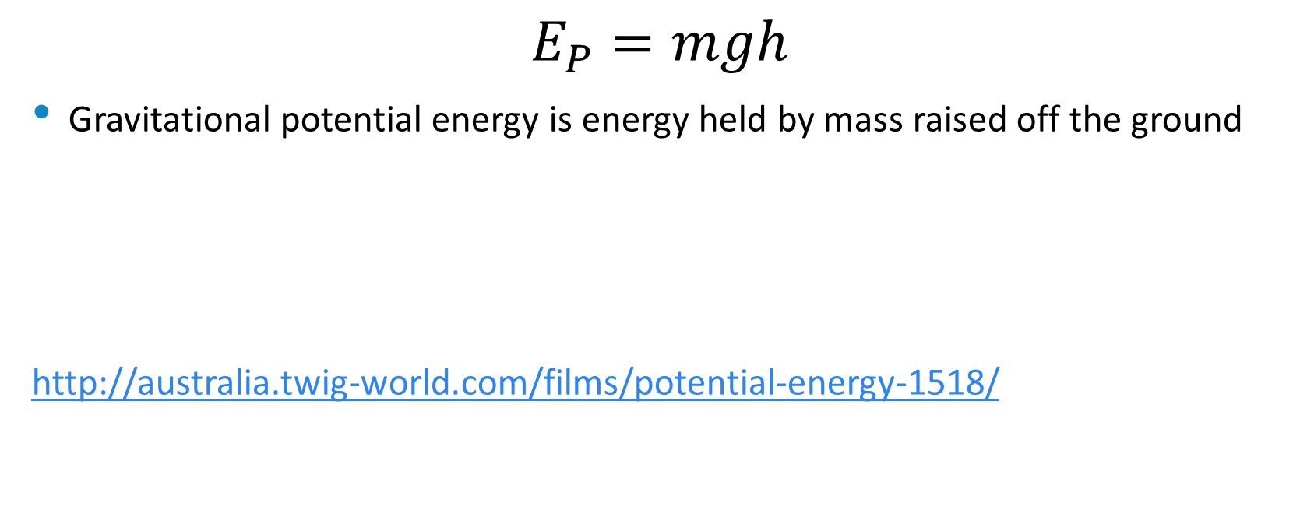
Gravitational Potential Energy
$$E_{P}=mgh$$
Gravitational potential energy is energy held by mass raised off the ground
http://australia.twig-world.com/films/potential-energy-1518/

Slide 73

Kinetic energy
$$E_{K}=\frac{1}{2}mv^{2}$$
Kinetic energy is energy held by mass in motion

Slide 74
Elastic vs inelastic collision
When two objects collide the collision may be elastic or inelastic
In an elastic collision the total kinetic energy held by the two objects doesn’t change
In an inelastic collision some of the kinetic energy is lost to other forms such as heat and sound

Slide 75
Example:
A 1.5 x 10³ kg car is moving to the right at 20 m s⁻¹ while a 5.0 x 10³ kg truck is moving to the left at 10 m s^{‑1} . The car and truck collide and move off as one mass stuck together.
What is the velocity of the wreckage immediately after the collision.
How much kinetic energy is lost as heat or sound when the car and truck collide?
3.1 ms⁻¹ left 5.2 x 10 ⁵ J

Slide 76
Total mechanical energy
Sum of kinetic energy and gravitational potential energy
Energy held by mass due to its position in and motion through a system

Slide 77
Example 1
Calculate the kinetic energy and hence the velocity required for a pole vaulter to pass over a 5.0m high bar. Assume the vaulter reaches a maximum height equivalent to the level of the bar with a horizontal velocity of 1.2 m/s. Use g = 9.8 ms⁻². Mass of man is 75kg.
9.97m/s

Slide 78
Example 2
A climber abseiling down a cliff uses friction between gloved hands and the climbing rope to slow down. If a climber with mass of 75 kg abseils down a cliff of 45.0 m reaches a velocity of 5.20 m/s by the time he reaches the ground, determine the average frictional force applied by his hands on the rope.
F = 712.5 N

Slide 79
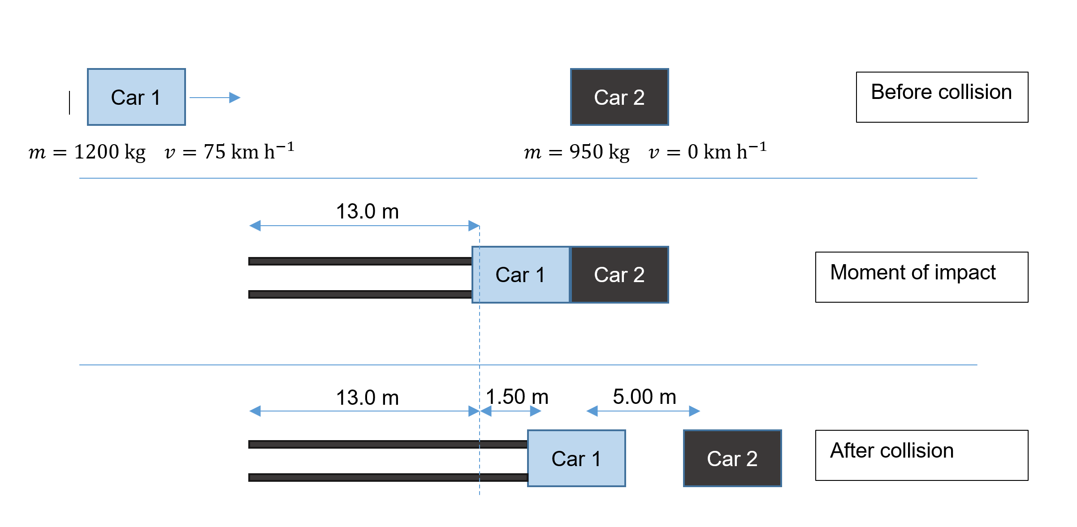
The reconstruction of a traffic accident based on the testimonies of eyewitnesses and evidence found on the road is shown below in three stages; before the collision, at the moment of impact, and after the collision. The skid marks seen in the diagrams reveal the distance over which Car 1 was braking hard. Car 1 has a maximum braking force of 16800 N. You may assume that Car 1 only ever applied the full force of its brakes and that it has come to a stop in the third diagram below.
Explain whether a car crash is an example of an elastic or inelastic collision. (3 marks)
Show that the velocity at which Car 1 collided with Car 2 is approximately 8 m s⁻¹. (4 marks)
Calculate the velocity of Car 1 just after the moment of impact. (2 marks)
Hence, calculate the velocity of Car 2 just after the moment of impact. If you could not determine an answer to part (c) you may use 6.50 m s⁻¹. (3 marks)

Slide 80
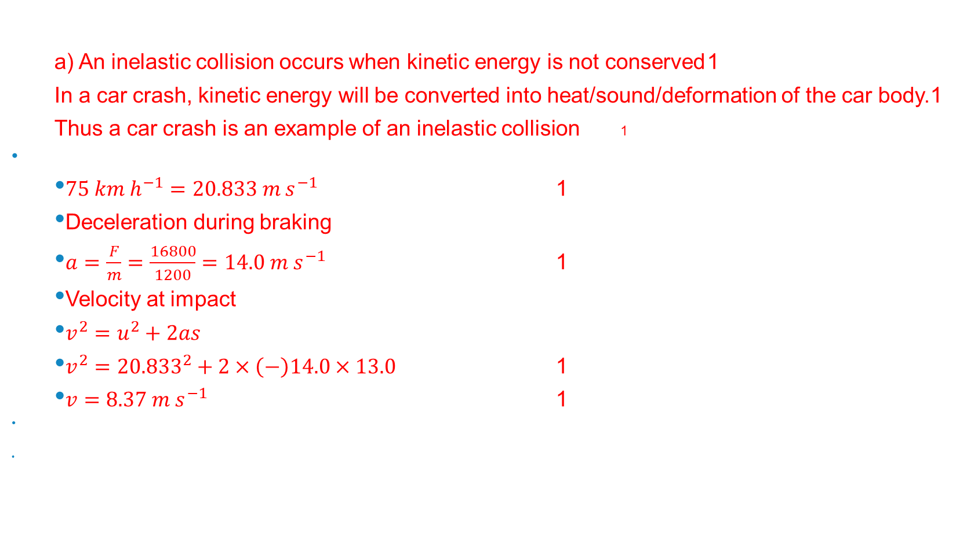
Answers
a) An inelastic collision occurs when kinetic energy is not conserved 1
In a car crash, kinetic energy will be converted into heat/sound/deformation of the car body.1
Thus a car crash is an example of an inelastic collision 1
$75 km h^{−1}=20.833 m s^{−1}$ 1
Deceleration during braking
$a=\frac{F}{m}=\frac{16800}{1200}=14.0 m s^{−1}$ 1
Velocity at impact
$v^{2}=u^{2}+2as$
$v^{2}={20.833}^{2}+2×\left(−\right)14.0×13.0$ 1
$v=8.37 m s^{−1}$ 1

Slide 81

c)
$v^{2}=u^{2}+2as$
$0^{2}=u^{2}+2×\left(−\right)14.0×1.50$ 1
$u=6.48 m s^{−1}$ 1
d)
$\sum{p_{before}}=\sum{p_{after}}$
$mu_{car 1}=mv_{car 1}+mv_{car 2}$ 1
$1200×8.37=1200×6.48+950×v$ 1
$v=2.39 m s^{−1} (2.36 m s^{−1})$ 1

Slide 82
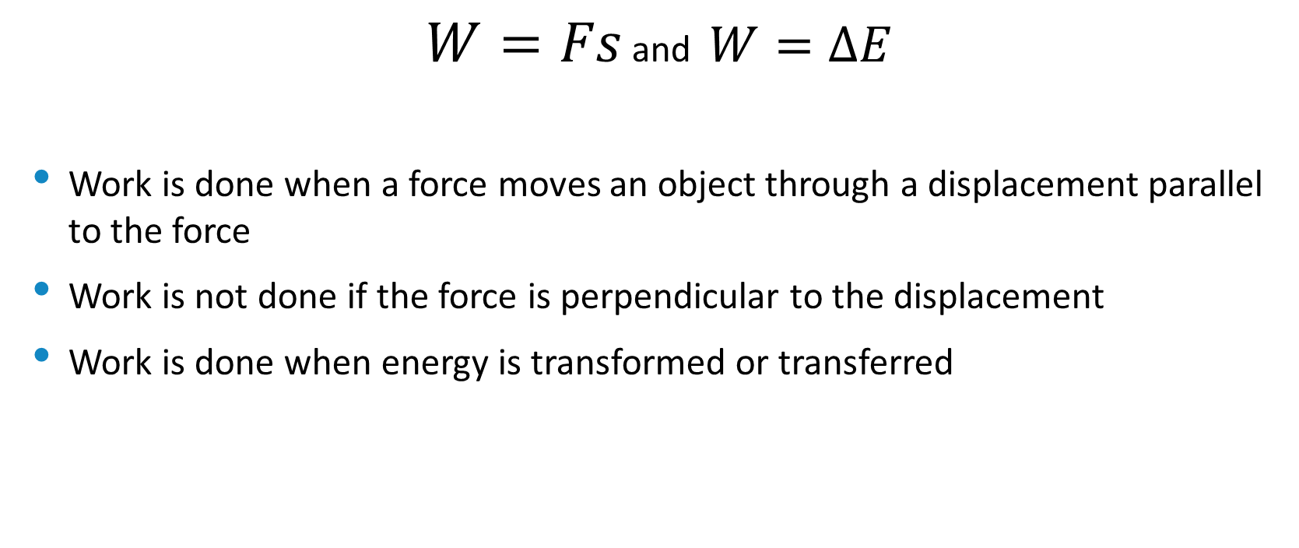
Work
$W=Fs$ and $W=∆E$
Work is done when a force moves an object through a displacement parallel to the force
Work is not done if the force is perpendicular to the displacement
Work is done when energy is transformed or transferred

Slide 83
Degradation of energy
When energy is converted into an unuseful form of energy.
Energy transformations are rarely perfect, often transform some energy into ‘waste’ energy
E.g. to heat due to friction and air resistance.
Minimise frictional force by:
Lubrication
Bearings, rollers
Streamlining

Slide 84
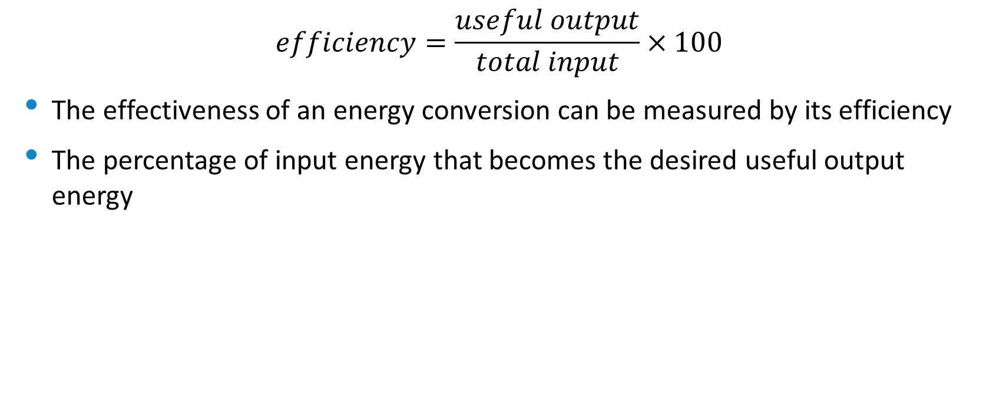
Efficiency
$$efficiency=\frac{useful output}{total input}×100$$
The effectiveness of an energy conversion can be measured by its efficiency
The percentage of input energy that becomes the desired useful output energy

Slide 85

Power
$$P=\frac{W}{t}= \frac{∆E}{t}$$
Rate of doing work
Measured in J s⁻¹, known as watts (W)
[or by some lunatics in the lighting industry, VA]

Slide 86

Other equations for power
$$P=\frac{W}{t}$$
W=Fs, so:
$$P=\frac{Fs}{t}$$
s/t=v so:
$$P=Fv$$
Power needed to maintain an object moving at constant velocity

Slide 87
Bibliography
BBC. (2021). Motion-Equation Graphs. Retrieved from Bitesize: https://www.bbc.co.uk/bitesize/guides/zgbggk7/revision/4

